Slide 1
Construction Use Tax Seminar
City of Loveland
Revenue division

Slide 2
Construction Use Tax is a 3% tax applied to construction and building materials pursuant to Tax Code 3.16.040

Slide 3

Methods of Collection
Pay construction use tax with the building permit.

Slide 4
BUILDING PERMIT
The Building Division will give you a building permit and collect the construction use taxes.
Show your building permit to any vendor you are purchasing materials from for the project listed on the building permit.
Give your subcontractors a copy of the building permit.
Once your project is completed and you’ve received the final Certificate of Occupancy or Letter of Compliance, file the Job Cost Reconciliation (JCR) with the City of Loveland, Revenue Division.

Slide 5
BUILDING PERMIT Cont…
IF your project is for an exempt organization you MUST:
    FIRST apply for a contractors exempt certificate with the Colorado Dept of Revenue. (this process can take several weeks so plan accordingly).
    The exempt number will start with 89-xxxxx.
    Provide your exempt certificate to the City of Loveland Building Division when getting a building permit.

Slide 6
Job Cost Reconciliation (JCR)
The JCR is a spreadsheet that accounts for all invoices and all money related to the project.
You must maintain records for all projects for a minimum of 3 years from the Certificate of Occupancy date.
The Sales Tax Department will review the JCR and communicate with you when further documentation is needed.
        Examples of additional documentation:
          Invoices, change orders, the building contract.
        Sub-contractors may also be called for clarification on invoices.

Slide 7
Job Cost Reconciliation (JCR) Cont….
The JCR will reconcile for the city construction use tax only. The county has their own reconciliation process and you will have to contact them for the county use tax.
There are two tabs/spreadsheets on the JCR
  1) Job Cost Ledger
  2) Net Tax-Refund Due
Email your JCR and supporting documentation to Pat.Walker@cityofloveland.org

Slide 8
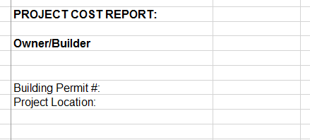
JCR – In Detail
Add the owner/ builder name and address in the column to the right of Owner/Builder. This is the name and address that will go on any refunds or balance due notices.
Add the building permit # and the project location. This is needed to properly reconcile the construction use tax per the building permit.

Slide 9
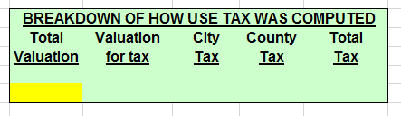
JCR – In Detail cont….
Enter the total valuation from your building permit in the yellow box.
The spreadsheet has a formula that will auto calculate the rest of the cells in this box.

Slide 10
JCR – In Detail cont….
Example Categories:
Concrete
Interior Doors
Electrical
Drywall
Landscaping
Example Vendor & SubContractor:
ABC Corp
John’s Flooring
Concrete Guy’s
Drywall LLC
Painting Pro’s
The Invoice Total includes everything on the invoice.
Choose the correct column for the taxable materials.
If a non-taxable item is listed on the invoice, i.e. Labor, put it in the Non Tax/ Other column.
Take the actual tax paid per the invoice and place it in the correct columns.
  Note – Invoices showing that Loveland city tax was paid needs to be sent in with the JCR.
Example Comment By Owner/Builder:
Used 50/50
Example Comment By Auditor:
Reviewed invoice – no change

Slide 11
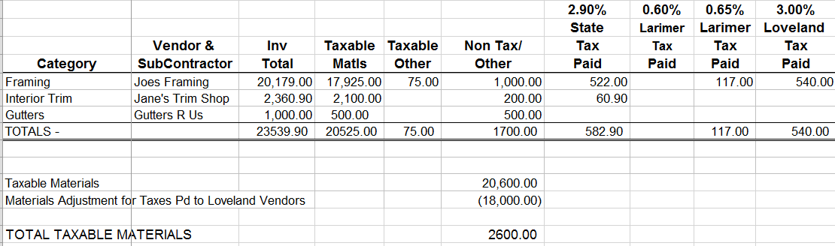
JCR – In Detail cont….
Job Cost Ledger - Example
Total of All Taxable Columns
540/3% = 18,000
Credit for Loveland Taxes Paid

Slide 12
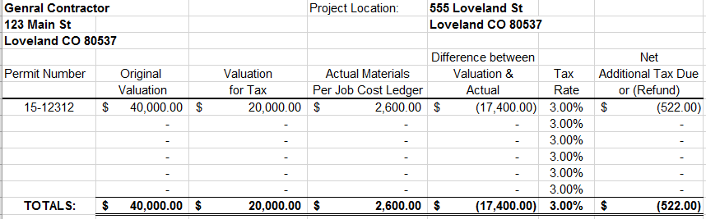
JCR – In Detail cont….
Net Tax-Refund Due - Example
This information is pulled from the Job Cost Ledger.
You will not need to make any adjustments to this page if you have filled out the
Job Cost Ledger correctly.

Slide 13
THANK YOU FOR ATTENDING !
City of Loveland Contact Information
Pat Walker (JCR’s): Pat.Walker@cityofloveland.org
970-962-2702
General Sales Tax: 970-962-2708
Website www.cityofloveland.org/salestax
Larimer County
Phone number 970-498-7000
Website www.Larimer.org

