Slide 1
Development of a Homeless Strategic Plan for the City of Loveland

Slide 2
Community Planning Meeting
Agenda
Welcome and introductions
Overview of agenda
Project overview
Early observations and impressions
Break
Small group work
  Provider survey questions
  Community survey questions
  Best practice research
Small group presentations
Wrap-up

Slide 3
Project Team
Gary Sanford – Project Lead
Margay Witzdam – Research Assistant
Cullen Dilldine, Tressa Nawyn – MSW students
Burnes Center on Poverty and Homelessness
Zoe LeBeau, Katie Symons
LeBeau Development
Jennifer Lopez
Project Moxie
Vanessa Fenley
Consultant

Slide 4
PHASE 1: Systems-level evaluation of current efforts
Collect and synthesize information
  Interview key stakeholders, including Councilmembers and Mayor
  Survey providers and others not interviewed
  Gather information from those with lived experiences
Gain an understanding of local efforts
  Review local/regional documents
  Assess current system and services
  Learn about the work of the HS and AH Commissions
  Identify areas of collaboration
  Become familiar with local data collection including use of HMIS
  Analyze local policies
  Identify gaps in housing and service continuum
Gather best practice information
  Identify efforts in similar sized communities
  Conduct research to identify best practices

Slide 5
PHASE 2: Develop an actionable management plan
Facilitate community meetings to gather input
Summarize interview information for discussion
Determine broad goal areas based upon Phase 1 information as well as community input
Review best practice information relative to gaps
Identify and prioritize objectives within goal areas
Determine short-, medium- and long- range tasks
Develop task time frames and identify persons responsible within actionable management plan

Slide 6
PHASE 3: Develop a Strategic Implementation Plan
Finalize actionable management plan
Provide recommendations in following areas:
  Governance structure
  Replication/expansion of successful efforts
  Best practices – strengthen existing systems & services
  New partnerships/providers to address gaps
  Scaling resources and policies across region
  Housing inventory with future needs
  Use of data to inform plan progress and future revisions
  Incorporate those with lived experience into formal roles
  Community education strategies
Present draft plan to community stakeholders for input
Finalize plan

Slide 7
PROJECT APPROACH
Incorporate a variety of voices and participation
Use data to drive understanding of current systems and future decision-making
Collaborative involvement across sectors and geography
Transparency throughout the process
Actionable strategies with measures

Slide 8
LOVELAND ASSETS
Jumpstart Court
Political will
City staff leadership
Committed non-profits
Involvement of faith communities
Regional partnerships
Coordinated entry system
Partners providing housing continuum
Volunteer involvement
Library
Other assets?

Slide 9
Community Stakeholder Interviews
37 nonprofit leaders and public entities were interviewed about homelessness in Loveland.
Percentages presented are valid, meaning they exclude missing data.

Slide 10
What influences your perceptions and understanding of homelessness in Loveland?
Personal experience (85.7%) was the most influential factor when it comes towards forming perceptions and understandings of homelessness, followed by colleagues and neighbors (42.9%).

Slide 11
Rate how homeless service data at local and regional level is currently used to improve services, assess policies, and/or educate Loveland citizens
Don’t know 7.7%
Very poor 46.2%
Poor 30.8%
Poor-Average 7.7%
Average 7.7%

Slide 12
How do those experiencing homelessness impact public systems?
Interviewees perceptions of systems most impacted by homelessness included jail, court, libraries, police, EMT and fire, and healthcare and hospitals, in that order.

Slide 13
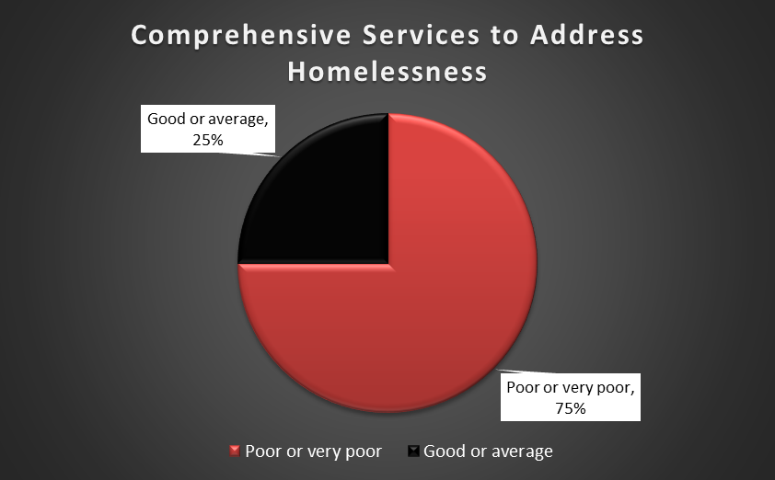
Stakeholders were asked to rate the comprehensiveness of
local services to address homelessness:
75% of responses rated the comprehensiveness of local services as either poor or
very poor.

Slide 14
Themes from Community Interviews
Loveland lacks necessary resources
“The town is tiny, lacking resources (to address homelessness) and pushing people out to Ft. Collins.” “Loveland is not getting its fair share of funding resources (goes to the County seat, which is Ft. Collins). Loveland is “just coming of age.”
Regional approach to address homelessness
“Regional approach is so critical- we have to come together as Northern Colorado (including Weld and Larimer) – CHAPS system is working really well”
Housing affordability and access is a problem
“Housing is very competitive and expensive.”
“Landlords are not wanting to accept vouchers.”
“Rental market is out of reach for many.”
“Loveland HA does assist in developing more housing”
“‘Affordable rent is difficult to find - we don’t have affordable housing.”

Slide 15
Themes Analyzed from Community Interviews
Community perceptions are a problem and barrier
“Articles on loitering and theft in downtown area”
“Needles being left on bike trails, parks, etc.”
“Not very positive perception…Seen more as a problem as opposed to people being human beings.”
“Social media impact upon those experiencing homelessness – sharing negative stories, perpetuating misperceptions”
Debate: Most effective ways of helping people in need
Housing should be earned vs. being a privilege or a right
Providing a hand-up vs. a hand out
Perceptions of deserving vs. undeserving

Slide 16
Lived experience focus groups
Over 50 individuals with lived experience participated in two focus groups in December
38 individuals with lived experience completed demographic surveys
The following information includes written responses as well comments provided during the focus group meetings
Percentages presented are valid percentages, meaning they exclude missing data.

Slide 17
Information about focus group participants
71.1% identifying as male and 28.9% identifying as female
75.7% of interviewees were individuals, with 1 single parent family and 1 two parent family.

Slide 18
How long have group participants lived in Loveland?
Of the 38 individuals, 16 (42.1%) reported having lived in Loveland for over 10 years.

Slide 19
Group participants identified the reasons that led to their homelessness
The majority of interviewees reported an inability to find work or job loss as a major factor.
Other common reasons included could not pay or afford rent and physical or mental health issues.

Slide 20
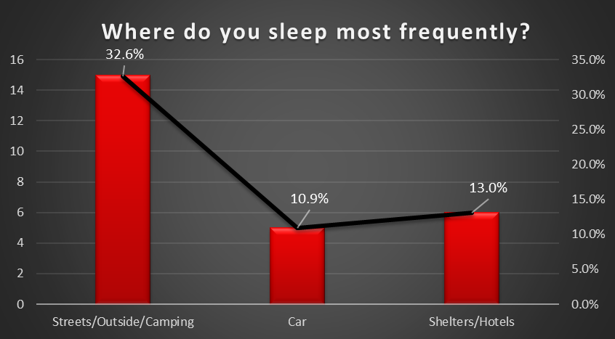
Where group participants reported sleeping most frequently
The majority (67.6%) of interviewees reported sleeping either on the streets, outside, or camping.
Others reported either sleeping in cars, hotels, shelters, or some form of temporary housing such as a garage or couch surfing.

Slide 21
Themes from focus groups
Bias, stereotypes and negative perceptions
“One bad person makes community view all of us as bad...”
“Everyone thinks homelessness is like a disease”
“Frustrated….feel mistreated…not treated as a citizen”
Barriers and biases prevent employment
“Employers don’t want to hire me because I am homeless”
“Difficult to save with low earning jobs”
Tension with some police officers
“There needs to be a liaison that works between homeless, the city and police”
“Need a homeless 101 training for police officers”
“Police look for us at night to move folks or give tickets”

Slide 22
Themes from focus groups
Reported treatment at local hospitals
“Treated poorly at McKee Medical Center – waited in wheel chair for 12 hours to be seen”
“Experience at hospital to address dislocated shoulder – labeled homeless – had to wait over 10 hours to get treatment”
Concerns with local services and gaps
“Unfair treatment by providers – some providers have their favorites”
“Treated poorly by some non-profit agencies”
“Limited access to bathrooms for hygiene and health maintenance”
“No services for women”
High barrier / requirements to access some services

Slide 23
Themes and Impressions
Themes | Challenges | Opportunities
Lack of community education and access to factual information | Attitudes (“hand up”) Limited data Fears, stereotypes | Data dashboard Education campaign Opportunities to learn from/with
Limited collection and use of data to inform decisions | Multiple data systems Sharing client data Data collection capacity | New HMIS system Coordinated entry
Local service continuum limited in capacity and resources | Gaps/siloed services High barrier requirements Limited resources | Community collaborations Volunteers Coordinated entry Provider meetings Ballot 1A approved
Lack of affordable housing | City ordinances Cost and resources NIMBY | New housing development Community housing Faith partnerships

Slide 24
BREAK

Slide 25
Small Group Work
Provider survey questions (Facilitator: Katie)
  What do we want to know?
  Brainstorm questions
  Provide suggestions and edits – limit to 10-15 questions
  Strategies to disseminate on-line survey
2. Community survey questions (Facilitator: Gary)
  What do we want to know?
  Brainstorm questions
  Provide suggestions and edits – limit to 10 questions or less
Best practice research in similarly sized communities (Facilitator: Margay)
  Review best practice matrix
  What is missing?
  What best practice areas do we want to learn more about?

Slide 26
Small Group report-out
  Questions
  Suggestions
  Next steps

Slide 27
Wrap-up
Questions and comments
Upcoming Community Planning Meetings
March 12, 2019 (9:00-12:00) at Loveland Library, Gertrude Scott Room
April 9, 2019 (9:00 –12:00) at The Edge club house
May 14, 2019 (9:00 –12:00) at Grace Community Church
June 11th(9:00 –12:00) at First Congregational Church
NOTE: Evening Community Planning Meetings will be added – stay tuned

