Slide 1
Boyd Parallel Interceptor (Phase 1) Project Construction Contract Award
Tanner Randall, PE - Senior Civil Engineer
January 17, 2018

Slide 2
Phase 1 Scope
~2,100’ of 24” Sanitary Sewer
~2,500’ of Storm Sewer
~2,100’ of Duct Bank
~2,900’ of Curb, Gutter, & Sidewalk
Complete Rebuild of Cheyenne Ave. and E. 17th St.
Phase 2
Design at 60%
LUC in April 2018
Construction Begins in May 2018

Slide 3
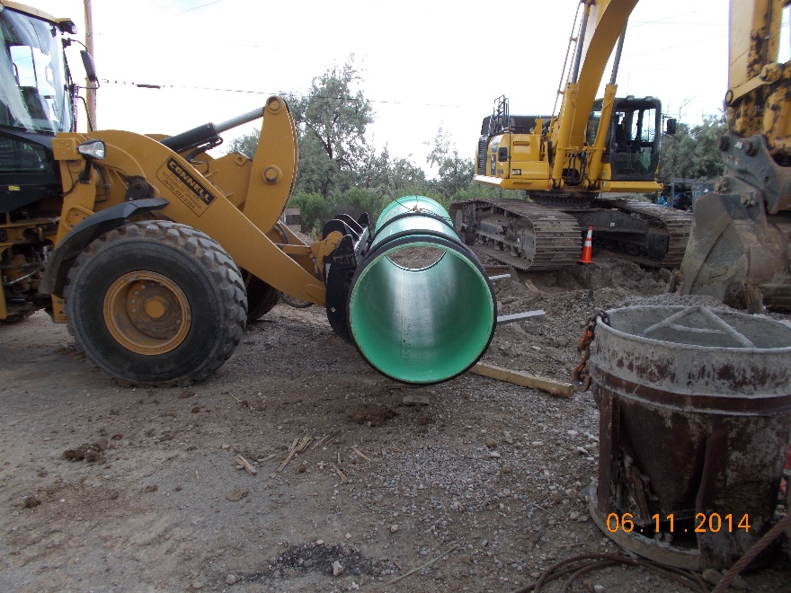
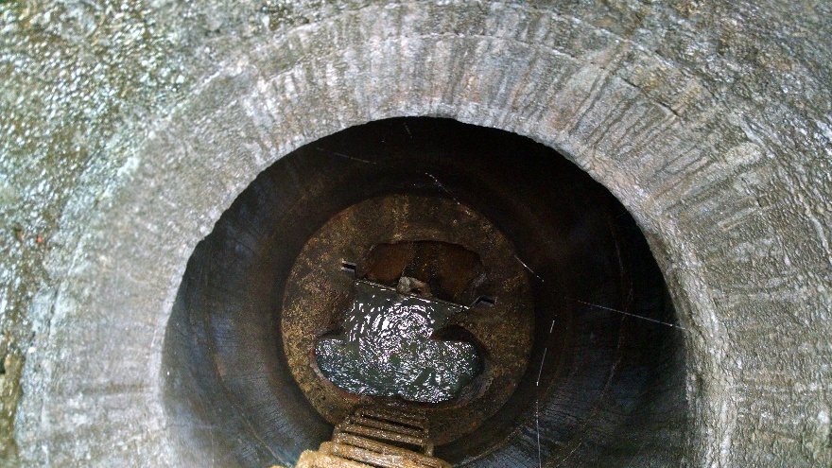
Phase 1 Contract
Connell Resources of Fort Collins, CO
Delivered via Construction Manager at Risk (CMaR) Delivery Model
Contractor Involved During Design
Independent Cost Estimate 0.3% Higher
There are Sufficient Funds to Sign the Contract
Contract Details
The Total Phase 1 GMP for the project is $3,550,202
Breakdown of the work between Departments is:
Wastewater: $1,760,725.20
Storm Sewer: $1,123,641.20
Electric Duct Bank: $434,164.80
PW Curb & Gutter: $189,932.30
PW Asphalt: $41,738.50

