Slide 1
Go forward. Go stronger. Go NoCO
Regional Tourism Act
Community Marketing Commission
By:
Marcie Erion

Slide 2
RTA REQUIREMENTS
Unique and Extraordinary
Result in substantial increase in out-of-state tourism (339,000 rooms nights generated)
Generate a significant portion of sales from non—Colorado residents ($3.2MM sales tax from out of state visitors)
BUT FOR, without state assistance the project is not likely to happen ($20MM ask)

Slide 3
Progress to date
Working on State RTA since July 2014
Pre-application turned in October 2014
Final application turned in February 17, 2015
Flexible dates from the State
August 28th, 2015: last date to subtract area in RTZ, add/subtract projects or change an element of a project
Award determination 4th Quarter of 2015
Projects receive unanimous approval to conduct negotiations
Final decision December 10, 2015

Slide 4
Go NoCO Projects:
2 Projects in Loveland
1 Project in Windsor
1 Project in Estes Park

Slide 5
Go NoCO Projects
PeliGrande Resort & Windsor Conference Center
Indoor Waterpark Resort of the Rockies
U.S. White Water Adventure Park
Stanley Hotel Film Center
*PGA Championship Tour
The Boathouse, Schussler Restaurant

Slide 6
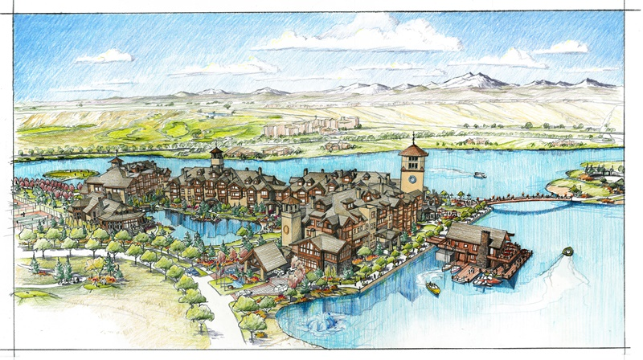
PeliGrande Resort &
Windsor Conference Center

Slide 7
Project:
300 Resort Hotel Rooms & Suites
2 full-service restaurants
Upscale lounge
Luxury spa
Fitness center
58,500 sq. ft. ballroom, meeting & pre-function space
Business Center
Gift shop
Retail services
Location:
Water Valley – New Liberty Rd. & Marina Dr. – Windsor CO
Projected opening
July 1, 2018
Cost:
Approx. $109,989,000
Total Out of Town Visitor Days:
145,854
PeliGrande Resort & Windsor Conference Center

Slide 8
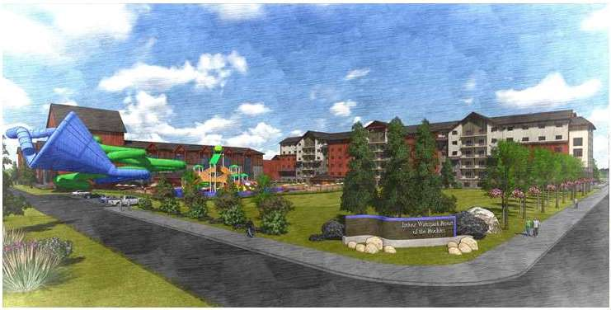
Indoor Waterpark Resort of
the Rockies

Slide 9
Project:
75,000 sq. ft. indoor waterpark
55,000 sq. ft. outdoor waterpark
20,000 sq. ft. family entertainment center
330 hotel rooms
3,000 sq. ft. Spa
250 seat, 7,500 sq. ft. restaurant/lounge
40,000 sq. ft. meeting space
3,000 sq. ft. retail space
Location:
North of Budweiser Event Center off I-25, Loveland, CO
Projected Opening:
2018
Cost:
Approx. $138,330,000
Total Out of Town Visitor Days:
307,757
Indoor Waterpark Resort of the Rockies

Slide 10
U.S. White Water Adventure Park

Slide 11
Project:
20 acre artificial whitewater river system
Zip lines & high ropes course
Obstacle courses
A canopy tour
Climbing wall
Children’s play area
Team building area
Restaurant
Retail shops
Amphitheater
Multi-purpose event space
Outdoor structures
Location:
North of Budweiser Event Center off I-25, Loveland, CO
Projected Opening:
2018
Cost:
Approx. $60,976,000
Total Out of Town Visitor Days:
378,020
U.S. White Water Adventure Park

Slide 12
Stanley Film Center
Project:
Horror Film Archive and Museum
Auditorium
Film School
Location:
Estes Park, CO
Projected Opening:
2018
Cost: $22,468,000
Total Out of Town Visitor Days: 221, 278
500 seat auditorium
13, 000 sq ft Film archive
Largest horror film archive
Rotating exhibits
Interactive tours
Sound Stage experience
Workshop spaces
Restaurant, gift shop and
concessions

Slide 13
Next steps:
Website is up and running
www.GoNoCO.org
Continued Community Outreach/Fundraising
Announcement of awards December 2015
If approved for funding, contract negotiations will commence, first quarter 2016, municipality negotiations would follow and then bonding efforts
Creation of the Regional Tourism Authority as governing body

